Slide 1
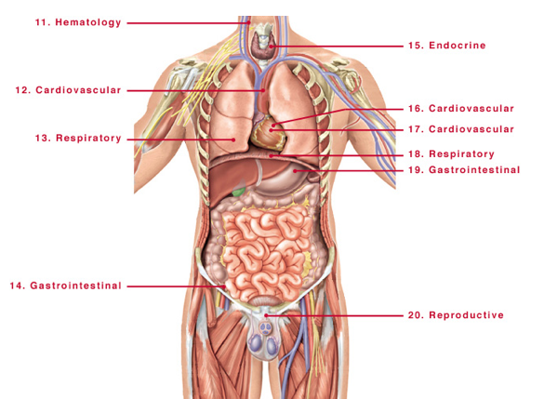
EPITHELIA = Epi (outside) thelium = “cloak”
Epithelial cells—all communicate with the outside world
---Squamous ( plate like and protective function)
epithelium lining the
Skin, ear canal, anus, cervix, vagina, esophagus--
--Columnar epithelium of
--Cells lining of the Trachea and lungs,
-- cells lining of the GI tract
--cells lining of the genitourinary tract
--cells of the liver ( makes bile which is excreted)
--cells of the pancreas—makes enzymes—excreted
--Cuboidal epithelium of—
--cells of the kidney tubules (remove the urine)
-cells of the ovarian follicle
--Transitional ( Bladder and ureter)
--”Endothelium “ ---One layer of squamous epithelium lines
the blood vessels—
no communication with the outside—
and so this is termed—”Endo” thelium.
http://medicalanatomy.net/human-body-organs-labeled/

Slide 2
EPITHELIUM is the term given to the cells that
-cover the exterior surface of the body,
-lines both the internal closed cavities of the body,
-lines body tubes that communicate with the exterior
(alimentary, respiratory, genitourinary)
-comprise the various organs (liver)
Epithelium can be
-impervious (epidermis or bladder) ,
-secretory (stomach),
-absorptive (intestines),
-be a transport system(trachea),
-receive sensory stimuli (taste buds of the tongue)

Slide 3
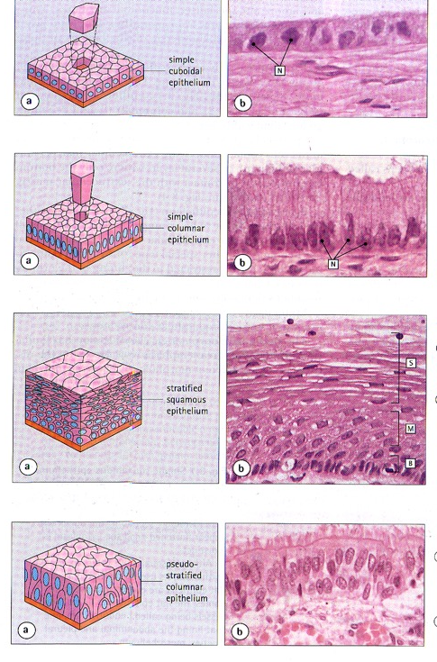
Diagrammatic representation of epithelial types

Slide 4
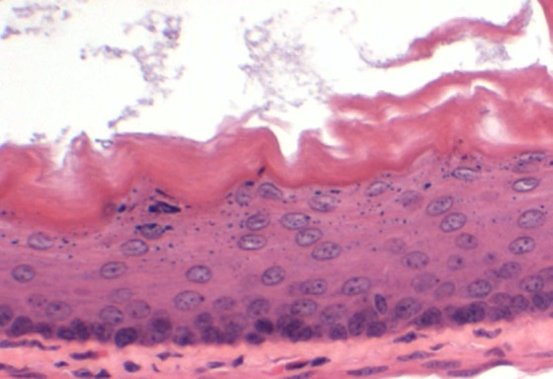
Epithelium can be impervious (epidermis or bladder) Stratified Squamous epithelium—stacked up like plates
Squamous epithelium function helps with shear forces that are encountered as in
-Skin, with anuclear keratin layer
-Esophagus(No keratin layer)
-Cervix (no keratin layer)
-External ear canal
-Anus

Slide 5
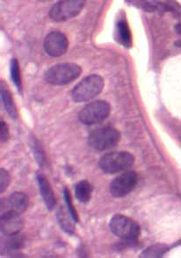
Epithelium can be secretory (stomach), absorptive (intestines),
Columnar epithelium—is so termed because the cells are arranged like columns
The height of the cell is greater than the width
Thus secreted material can be stored or secreted
Epithelial lining of intestine

Slide 6
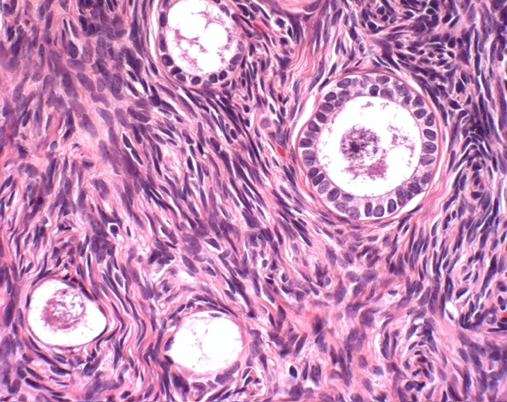
Ovary with developing follicles
Primordial follicles lined by flat squamous epithelium
Developing Primary follicles lined by cuboidal epithelium
Cuboidal epithelium
Stromal fibroblasts

Slide 7
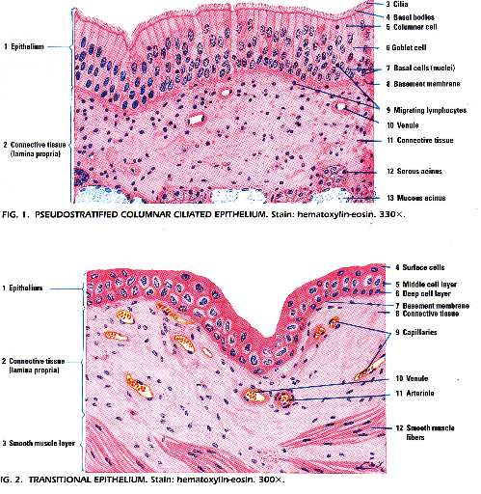
Pseudo-stratified columnar
(lining of trachea and ..)
Transitional:
lining
Bladder and ureter

Slide 8
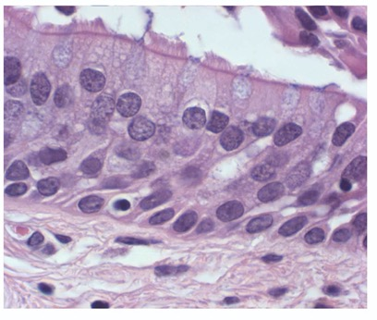
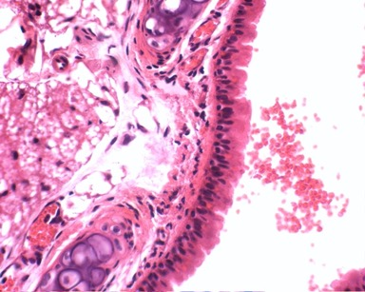
Pseudo-stratified Columnar epithelium
Mouse trachea
Human trachea

Slide 9
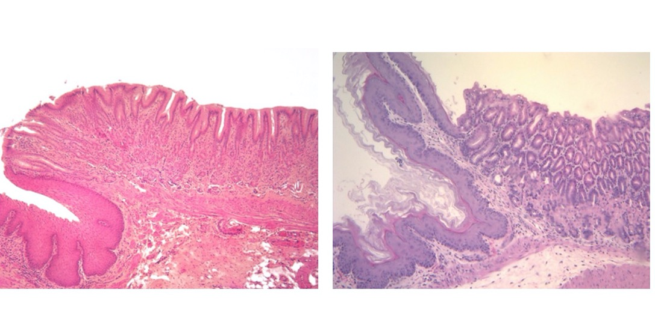
Junctional zone epithelium: Where epithelium of one kind changes naturally to another
Squamo-Columnar junction between esophagus and stomach in Human ( Left) and in the mouse stomach (right)

Slide 10
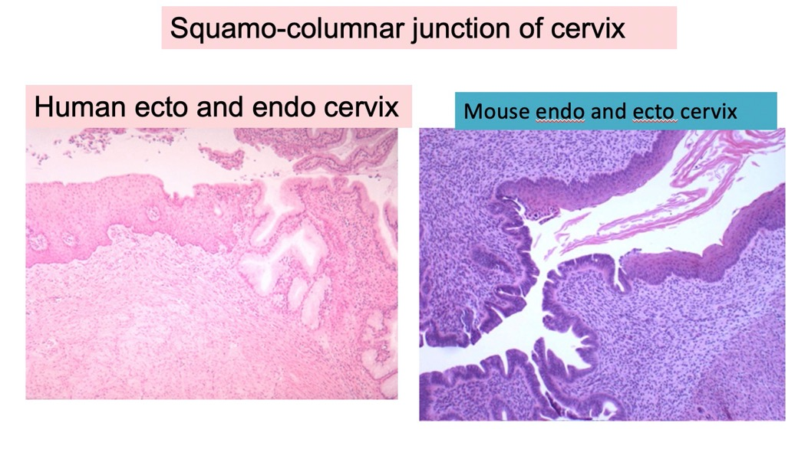
Junctional zone epithelium: Where epithelium of one kind changes naturally to another

Slide 11
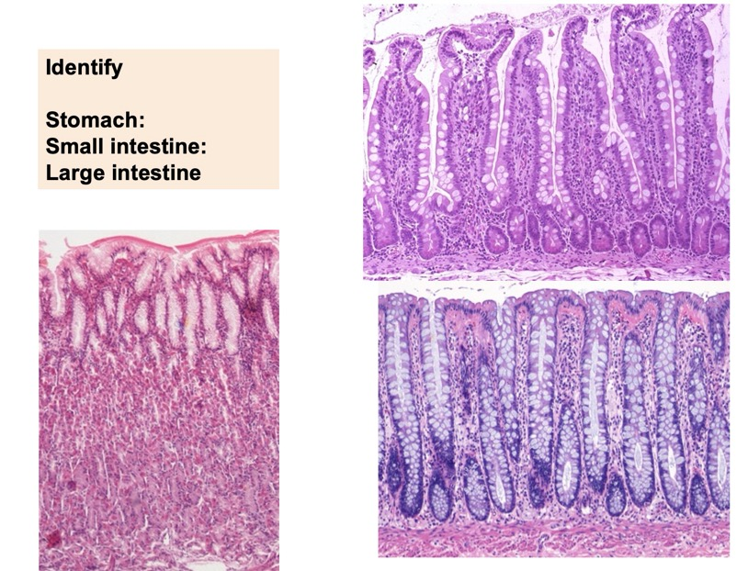
Different cell types with different functions in the GI tract

Slide 12
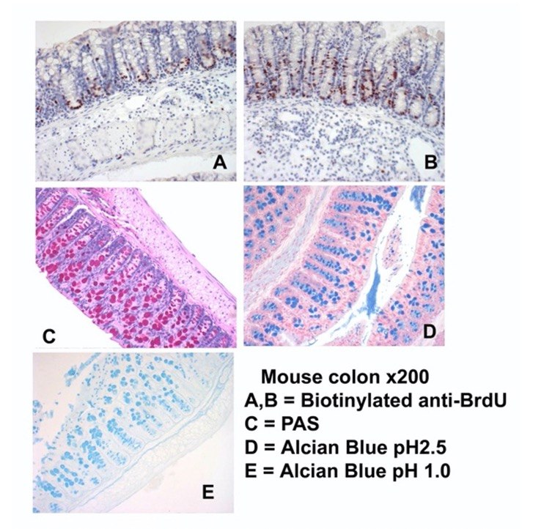
Colon is a good sample for use in a variety of histologic stains

Slide 13
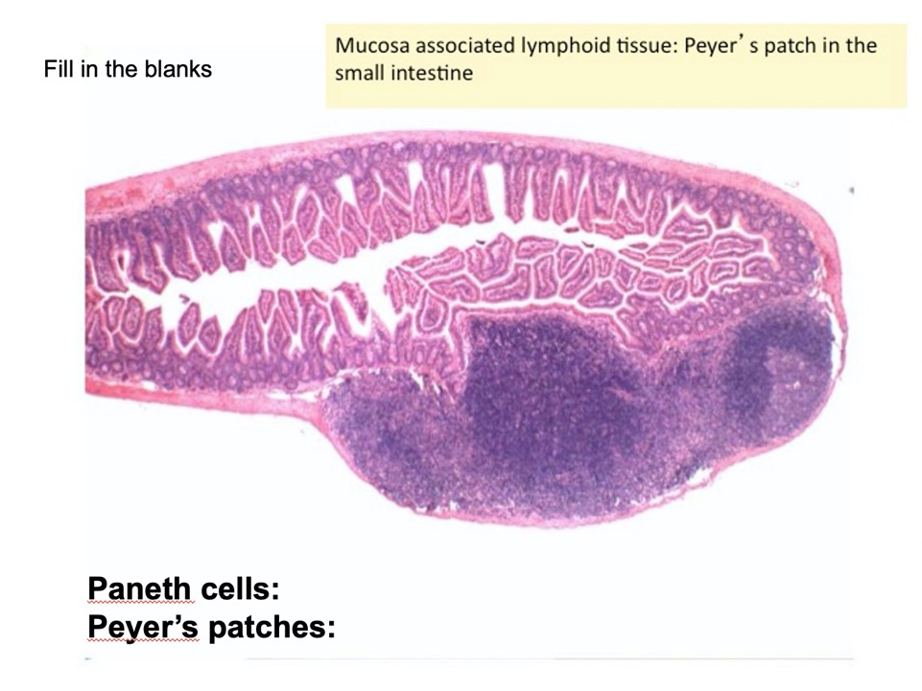

Slide 14
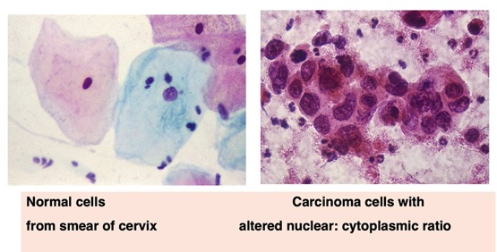
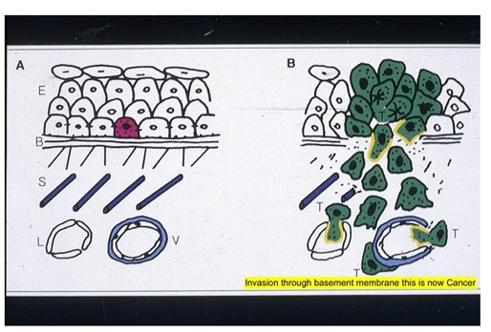
Benign = “Normal”
Malignant = neoplastic cells have invaded through basement membrane
Carcinoma = malignancy of epithelial cells
Sarcoma = malignancy of supporting cells
Once the neoplastic cells (Neo=New growth) invade the basement membrane, they can access underlying blood vessels to metastasize to distant sites

Slide 15
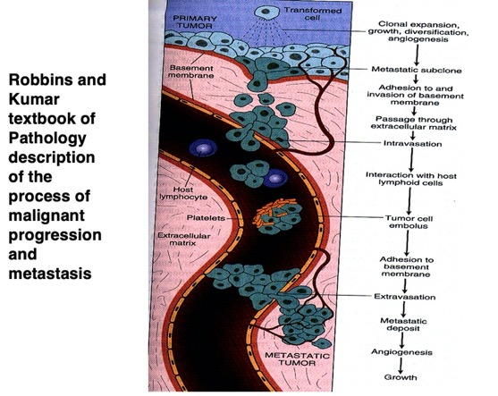
Supporting cells or “Stromal cell”
-Fibroblast
-endothelial cells of blood vessels
-Muscle—smooth, skeletal, cardiac
-adipose
-bone
--cartilage
Cells circulating in the blood
--red blood cells
--platelets
--white blood cells
-Neutrophils, Eosinophils, basophils
-Lymphocytes
-Monocytes—when these settle in tissues they are called macrophages (Macro)
--Macrophages in different organs have different functions
--microglia in the brain
` --Kupffer cells in the liver
--alveolar macrophages in the lung

Slide 16
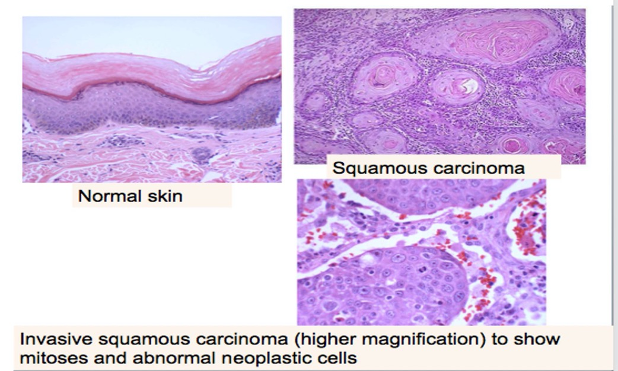

Slide 17
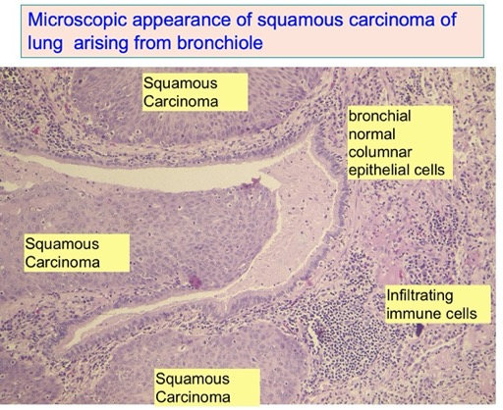
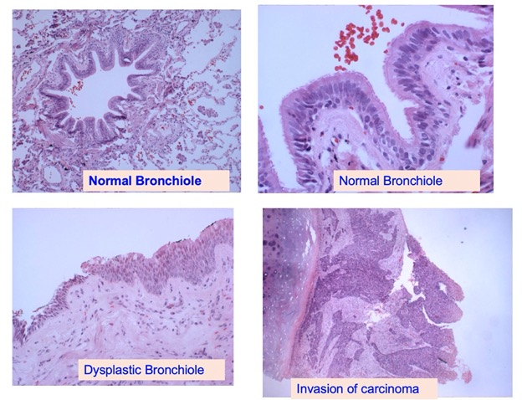

Slide 18
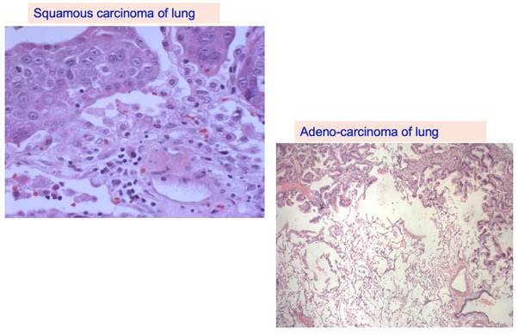

Slide 19
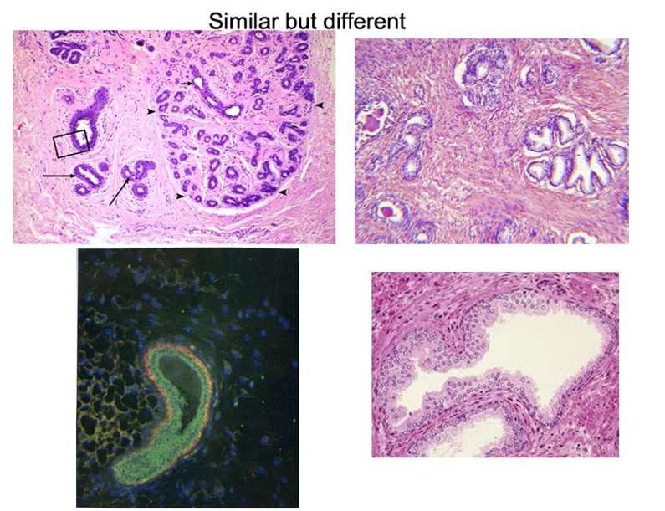
Human Breast
Human Prostate
Green= keratin expressing epithelial cells
Red = Smooth muscle actin expressing myo-epithelial cells

Slide 21
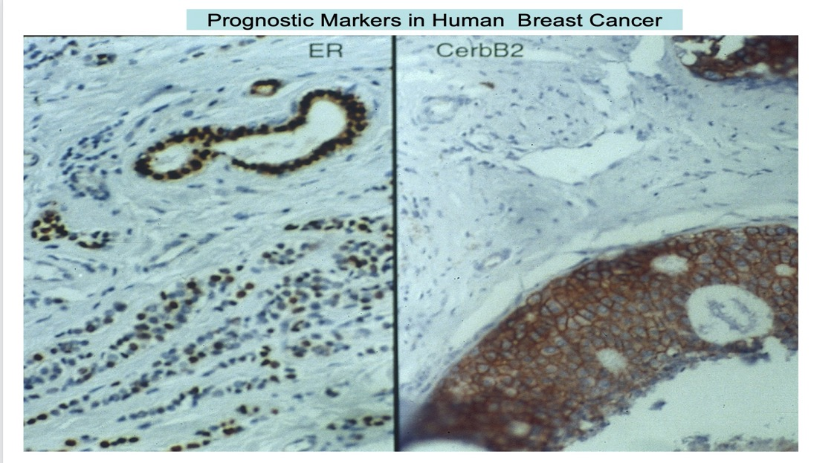

Slide 22
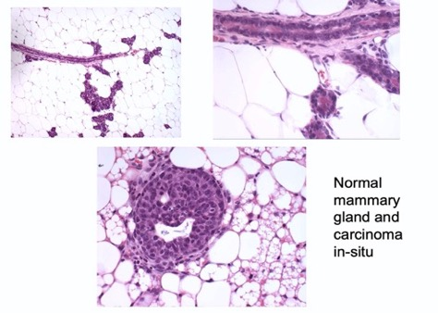
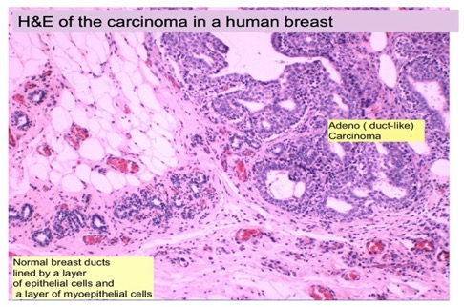
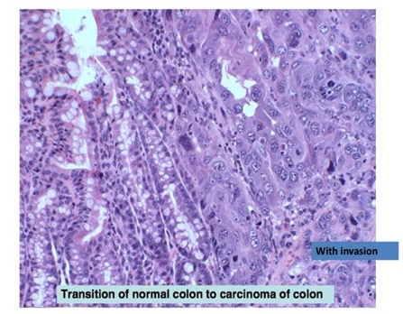

Slide 23
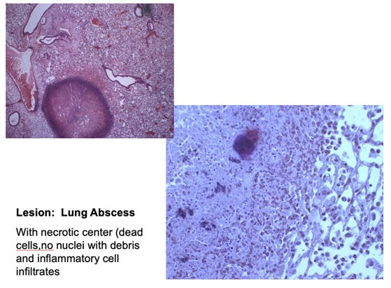
This is NOT a Neoplasm, but is necrotic
( death due to pathology of infections
or blood vessel compromise)
Here, due to the invasive organisms ,
which can be identified with a Gram stain

Slide 24
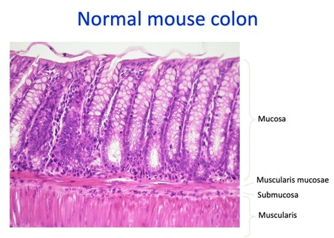
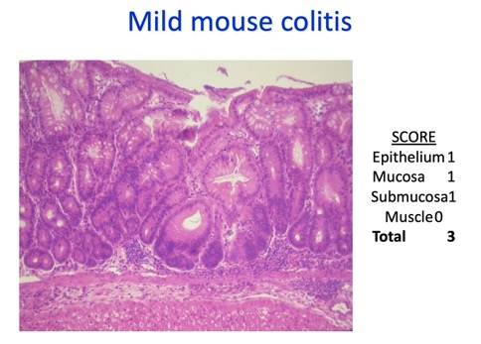
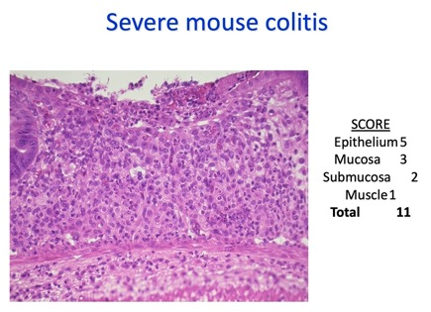
Mouse Models of Human Ulcerative colitis

Slide 25
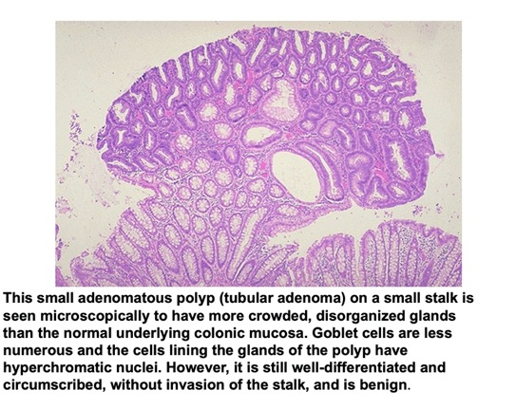
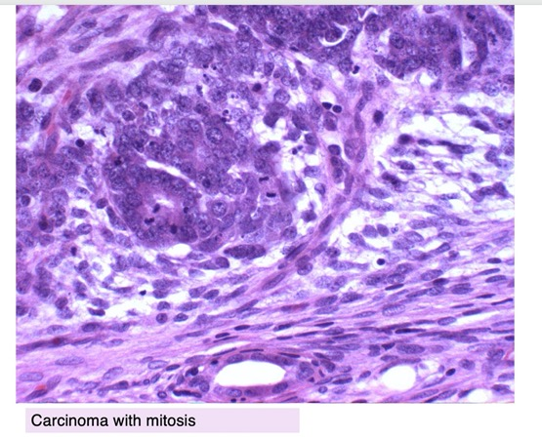
Colon Polyp—projects into the lumen and is lined by layers of tubular Neoplastic (new growth) cells—but there is no invasion into stalk
Adenocarcinoma—tubular structures with many layers of neoplastic cells—with lots of mitoses,and invasion of basement membrane

Slide 26
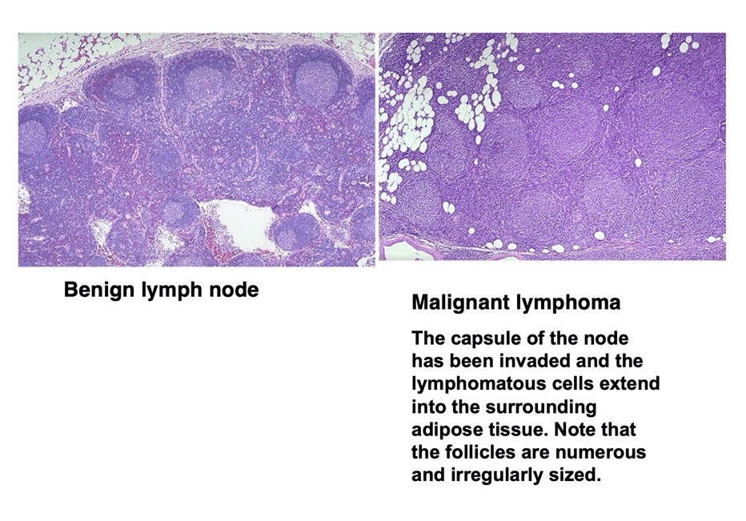

Slide 27
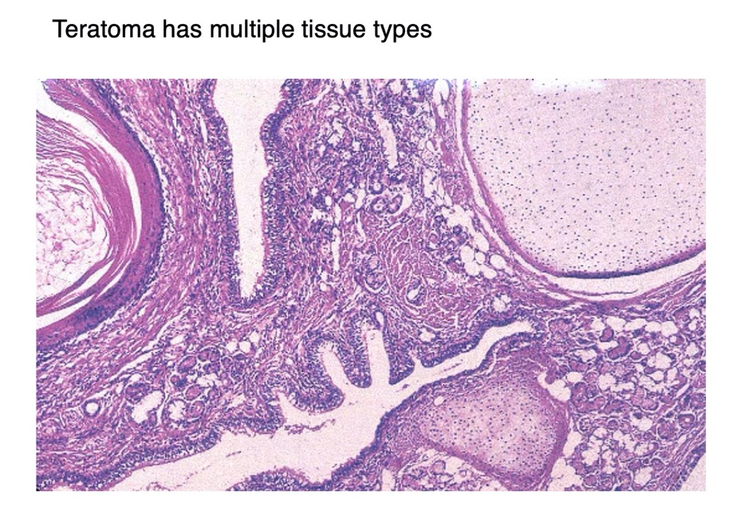

Slide 28
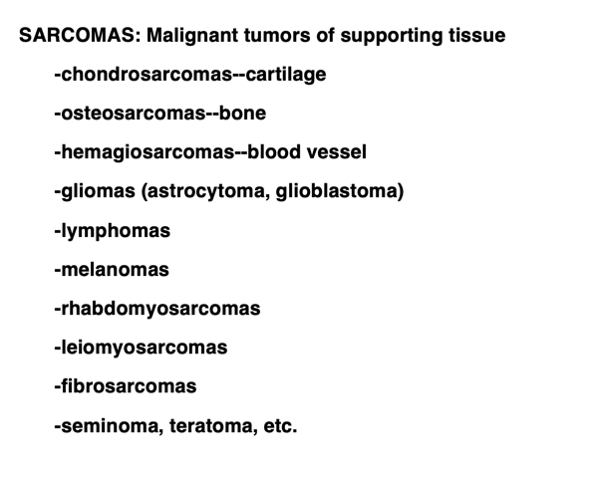

Slide 29
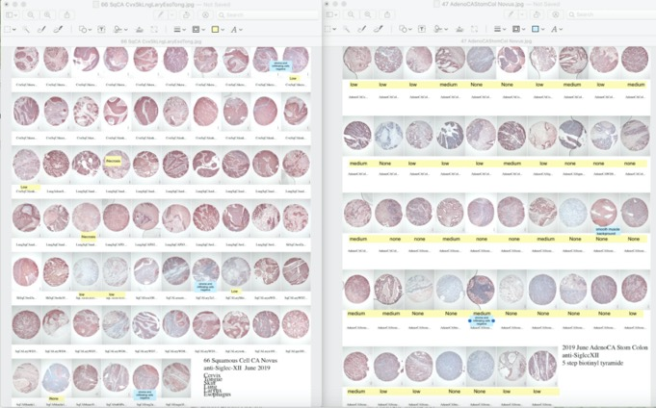
A Panel of 66 Human Squamous Carcinomas on the left—show more expression of SiglecXII,
compared to the panel with 47 Human Adenocarcinomas on the right
An example of results using the 5 step with biotinyl tyramide enhancement with Mouse anti-SiglecXII on paraffin sections, Formalin Fixed Paraffin Embedded
( FFPE) Multi-tissue arrays ( MTA) from Novus Biological June 2019)

